Slide 1

Programming 1A PROG5121
Facilitated by Mr D S Govender
14 June 2023- 10:00 AM

Slide 2

Learning Unit 6 Theme Breakdown
LO 1: Define an Array
LO 2: Declare an Array
LO 3: Initialize an Array
LO 4: Refer to Array elements
LO 5: Passing Arrays to a method
LO 6: Returning Arrays from a Method

Slide 3

Learning Material
Prescribed textbook:
Farrell, J. 2019. Java Programming. 9th edition. Cengage Learning.
A free copy is available on EBSCOhost.

Slide 4
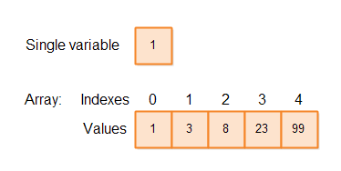
LO 1: Define an Array
What is an array?

Slide 5
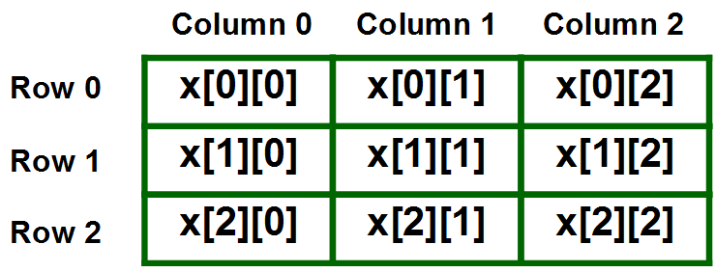
LO 2: Declare an Array and LO 3: Initialize an Array
int[] numbers = {1, 2, 3, 4, 5};
int[] numbers = new int[5];
numbers[0] = 1;
numbers[1] = 2;
numbers[2] = 3;
numbers[3] = 4;
numbers[4] = 5;
int[] numbers;
numbers = new int[]{1, 2, 3, 4, 5};
int[][] matrix = {{1, 2, 3}, {4, 5, 6}, {7, 8, 9}};
int[][] matrix = new int[3][3];
matrix[0][0] = 1;
matrix[0][1] = 2;
matrix[0][2] = 3;
matrix[1][0] = 4;
matrix[1][1] = 5;
matrix[1][2] = 6;
matrix[2][0] = 7;
matrix[2][1] = 8;
matrix[2][2] = 9;
int[][] matrix;
matrix = new int[][]{{1, 2, 3}, {4, 5, 6}, {7, 8, 9}};

Slide 6
LO 4: Refer to Array elements
int[] numbers = {1, 2, 3, 4, 5};
int firstElement = numbers[0];
int thirdElement = numbers[2];
int lastElement = numbers[numbers.length - 1];

Slide 7
LO 5: Passing Arrays to a method
int[] numbers = {1, 2, 3, 4, 5};
// Passing the array to a method
printArray(numbers);
}
public static void printArray(int[] arr) {
for (int i = 0; i < arr.length; i++) {
System.out.println(arr[i]);
}
}
}

Slide 8
LO 6: Returning Arrays from a Method
int[] numbers = getNumbers();
for (int number : numbers) {
System.out.println(number);
}
public static int[] getNumbers() {
int[] numbers = {1, 2, 3, 4, 5};
return numbers;
}
Output
1
2
3
4
5

Slide 9
Scenario: Student Grades
Suppose you are developing a grade calculation program for a school. The program needs to calculate the average grade of a student based on their individual subject grades. You want to store the subject grades for a student in an array and then calculate the average using the array.
Let us assume the following were the grade values:
75, 82, 68,77,48,50
Or
Make up your own values

